Slide 1
Classic Cards
Classic Cards in the Vlocity Cards Framework are UI components rich in information and actions relevant to the customer's context. The Classic Card Designer is a declarative tool to create cards and card layouts, with minimal HTML, CSS, and AngularJS coding.

Slide 2
Cards
A Vlocity card is a block that contains a combination of pertinent information and links to processes within a specific context. For LWC enabled cards
An account card, for example, includes unique account information, such as:
Status
Priority or service level agreement
Creation date
Actions on an account card might include:
Closing a case
Opening a new case
Creating a new task
Each action can launch an OmniScript to begin a guided process. An action can also open an external web address or application. With an LWC enabled card, you can fire a pubsub event from an action.

Slide 3
Card Flyouts
You can design a card to have an action that, when clicked, opens or "flies out" an additional card. A card flyout contains additional information and actions related to the parent card

Slide 4
Card Layouts
A card layout contains one or more cards. To create a new card, you must create a card layout for it.
When you create a new card layout, you can:
Choose existing cards to include in the layout
Create new cards to include in the layout

Slide 5
LWC Cards
Vlocity Lightning Web Components enables you to use standard JavaScript and HTML to modify and extend Vlocity Cards. Vlocity Lightning Web Components enables embedding Vlocity Cards inside OmniScripts, and leverages the Salesforce Lightning Web Components programming model for flyouts and editable states.

Slide 6
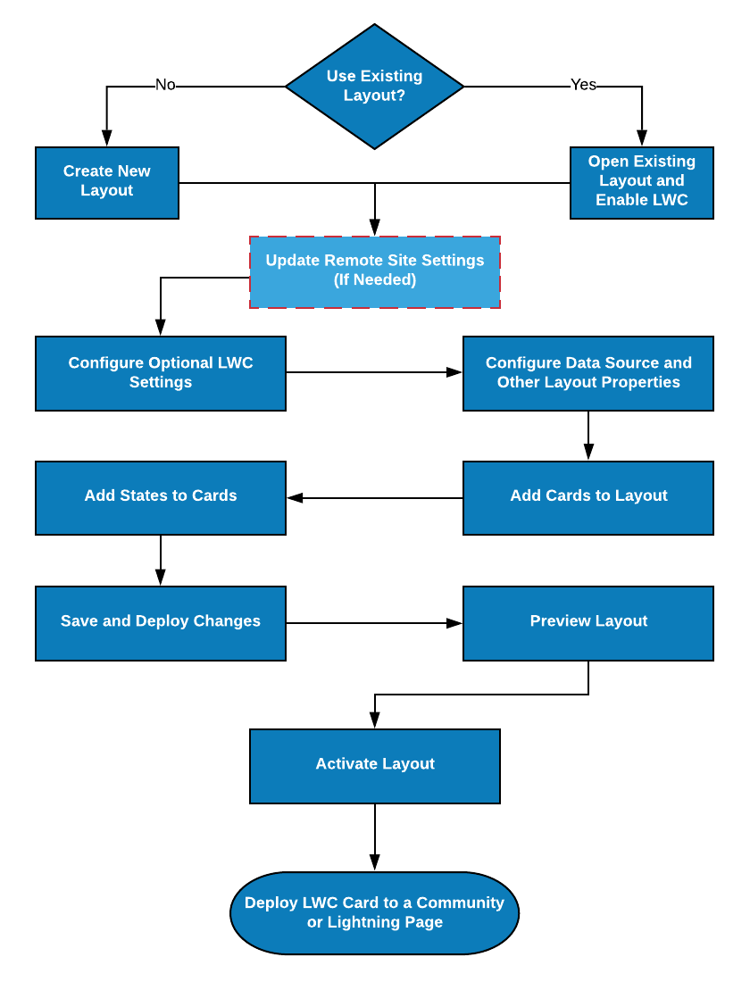
Creating an LWC Card Layout

Slide 7
Defining Metadata Values
Enter or update values for these properties:
Master Label: Update the visible name of your card component as you want it to appear in the Lightning App Builder and Community Builder. The default is the Layout Name defined in the Layout pane.
Description: Enter a description for your card component.
API Version: Defines the API version of your card component. The default is the API version used when creating the card component. When creating a new card, the default value is the current API version.
(Read-Only) Runtime Namespace: Defines the Vlocity package namespace.
Is Exposed: When enabled, your card component is public. By default, this feature is enabled.
Target Name: Select where your card component is accessible. By default, HomePage, RecordPage, and AppPage are selected to enable use on a custom home page, a record page, and an app home page.

Slide 8
Using Actions with LWC Cards
LWC Cards use Vlocity Actions, OS Actions, Custom Actions, Smart Actions, and PubSub Actions to launch procedures. For example, a card can launch an OmniScript, run an Apex class, redirect to a URL endpoint, launch an Integration Procedure, fire a pubsub event, and so on.
Vlocity Actions: Adds preconfigured actions created in the Vlocity Actions tool in your org. Vlocity Actions are reusable on multiple cards.
Custom Actions: Create an action unique to the card state. A custom action is not reusable on other cards.
OS Actions: Launch an OmniScript from your card state.
Smart Actions: Beginning with the Vlocity Summer '19 release, Vlocity supports generating and returning actions to an LWC Card at runtime by using a Vlocity Integration Procedure, which reduces server processing time, increasing performance.
PubSub Action: Beginning with Vlocity Insurance and Health Vlocity Spring '20, Vlocity supports firing pubsub events from an action on an LWC Card.

Slide 9
Card States
Cards have states. Each state displays a list of fields from either the layout or the individual card data source, plus a list of Vlocity Actions. You can also associate each state with a flyout, an extended version of a card with supplemental data displayed in a larger area.
Cards states enable presentation of different CRM interactions per state. For example, when a customer adds an auto insurance policy, the policy becomes active, but when a customer misses a payment the policy state becomes past due. Cards with different states present different data.

Slide 10
Cards Framework Versioning
The Vlocity Cards Framework supports versioning for all components. The name, author, and version combination must be unique for each component of a given type (layout, card, or template) in an org.
Field | Description
Name | Components are requested by name.
Author | Specifies the user organization that created the record. Use author names that describe the team creating the content. Vlocity-authored components have Vlocity as the author. You cannot modify these components, but you can clone them.
Version | An integer that increases by one with every new version.
Active | Indicates whether a record is active for runtime use. One active record per name is allowed in an org. Activating a component deactivates all other components of the same type that have the same name. Only active records are exported when a DataPack is created.

Slide 11
Activation in the Cards Framework
Multiple versions of a component can exist, but only one version at a time can be active. Activating one version deactivates all the others. Only active component versions are exported when you create a DataPack.

Slide 12
Versioning Best Practices
When working with Vlocity-authored components in a client org:
Set a unique name for the new component if you are only using the original component as a template to start from.
Set a unique author for the new component when replacing a Vlocity component with your own inside of a larger app. For example, inside of CPQ you can replace one component without having to overwrite and clone the whole app.
When you import DataPacks, components of the same type are matched by Name, Author, and Version combination. If this combination is not unique, a warning is displayed that there is a pending overwrite. Importing components doesn't create new versions of them.
Make sure to activate your components before creating a DataPack. When you export DataPacks, only active components are exported.
Use source control. This versioning workflow is not as fail-safe as the security that source control provides.
Use Vlocity build tools to work efficiently with imports and exports. For large or complex migrations, use the Vlocity Build tool, which is available from GitHub. The Build tool is a command-line tool that packages related objects together as DataPacks, ensuring that dependencies are preserved.

Slide 13
Using Actions with Cards
Cards use Vlocity Actions, OS Actions, and Custom Actions to launch procedures. For example, a card can launch an OmniScript, run an Apex class, redirect to a URL endpoint, and so on. For LWC enabled cards, see Using Actions with LWC Cards.
Vlocity Actions: Adds preconfigured actions created in the Vlocity Actions tool in your org. Vlocity Actions are reusable on multiple cards.
Custom Actions: Create an action unique to the card state. A custom action is not reusable on other cards.
OS Actions: Launch an OmniScript from your card state.

Slide 14
Configuring Action Options
Options available for all actions:
Custom Parameters: Enter additional parameters to send them with the request.
Conditions: Enter conditions to hide actions from specific users.
Options available only for Custom Actions:
Invoke Class Name: Enter an Apex class name to invoke through the action.
Invoke Method Name: Enter a method within the Apex class to invoke through the action.
Input Map: Enter key-value pairs to send as a Map object to the invoked Apex class.
Options Map: Enter key-value pairs to send as an Options Map to the invoked Apex class.

Slide 15
Configuring an Integration Procedure Data Source
Configure a data source to use a Vlocity Integration Procedure to execute multiple actions in a single server call.
Note
An Integration Procedure does not support the following data sources:
Salesforce Object Search Language (SOSL)
Streaming API
Off-Platform
Optionally, enter the values for the following:
Options Map: To pass additional parameters to the Integration Procedure, enter a name-value pair.
Return JSON Path: To drill down through the JSON data to pass a specific dataset to the cards, enter the JSON path. For example, enter Account.Cases to return data from the ‘Cases’ object only.
OrderBy: To change the order of the data returned, choose the data field by which to order the returned data.
Reverse Order: To reverse the order of the data returned, select True from the picklist.
Timeout (ms): To limit the time that the framework waits for the designated data source to return a response, set a timeout value in milliseconds.
Timeouts improve handling user interactions with long running processes. Setting an appropriate timeout value allows the application and users to react accordingly to long wait times.
Interval (ms): To continuously refresh the data and check for changes from the data source, set an interval value in milliseconds.
If changes are found, the layout or card component reloads. Setting an interval enables recursive updates of records.

Slide 16
Testing Data Source Settings
Add runtime variables to fetch and test your data source.
Preview a FlexCard using real data by adding test variables that the query can use to return live data.
In the Test Data Source Settings section, click + Add Test Variables
Set Name to (for example) params.id
Set Value to an actual record ID value.
Click the View Data button to view the JSON-formatted response.

Slide 17
Creating Zones
Zones enable you to arrange the information on a card layout into sections. Create zones in the Template Designer, add the zones to a layout in the Card Designer, then add cards or nested layouts inside the zones.

